Slide 1


Data Warehousing
By Rudra Patel (12002040701140)
Semester 4

Slide 2
OUTLINES:-
What is Data Warehousing
Data Warehousing Definition
History Leading to Data Warehousing
Need for Data Warehousing
Components
Advantages & Disadvantages
Architecture
DBMS vs Data warehousing

Slide 3
What is A data Warehousing?
A Data Warehouse is a powerful database model
That significantly enhances the user’s ability to
Quick analyse large, medium, multinational data
sets.
It cleanse and organizes data to allow user to
Make business decisions based on facts.
Hence, The data in the data warehouse must have strong.

Slide 4
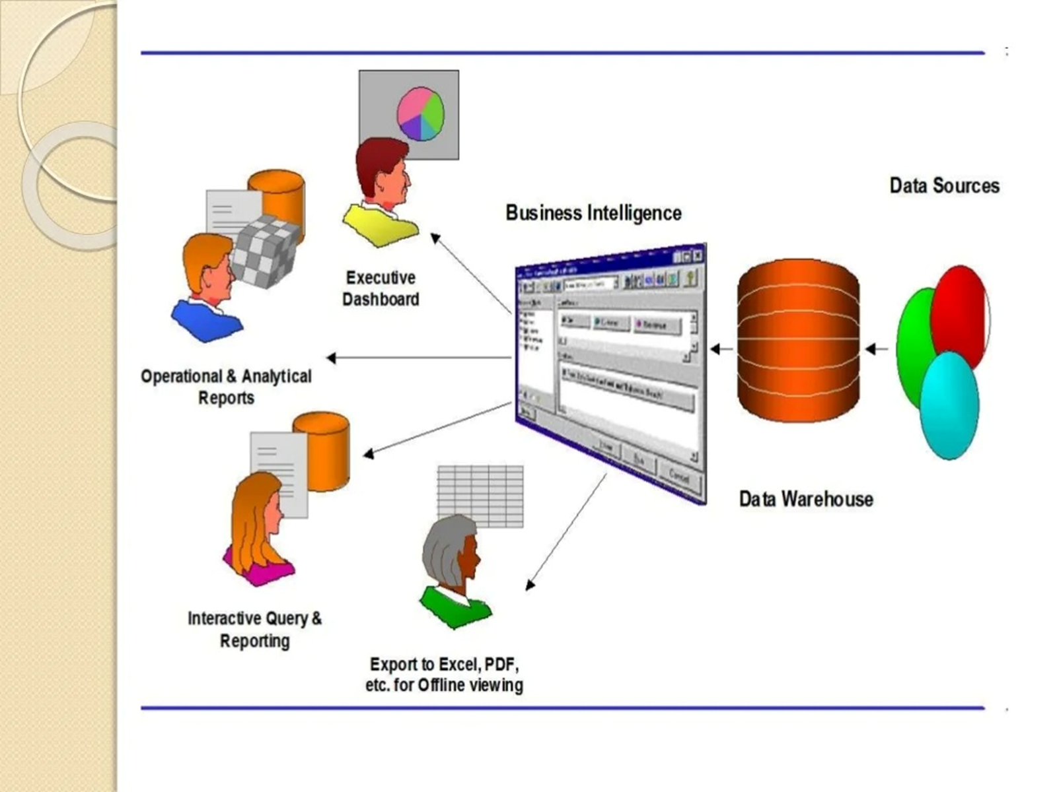

Slide 5
Definitions
Data Warehouse
A subject-oriented, integrated, time-variant, non-updatable collection of data used in support of management decision-making processes
Subject-oriented: e.g. customers, patients, students, products
Integrated: consistent naming conventions, formats, encoding structures; from multiple data sources
Time-variant: can study trends and changes
Non-updatable: read-only, periodically refreshed
Data Mart
A data warehouse that is limited in scope

Slide 6
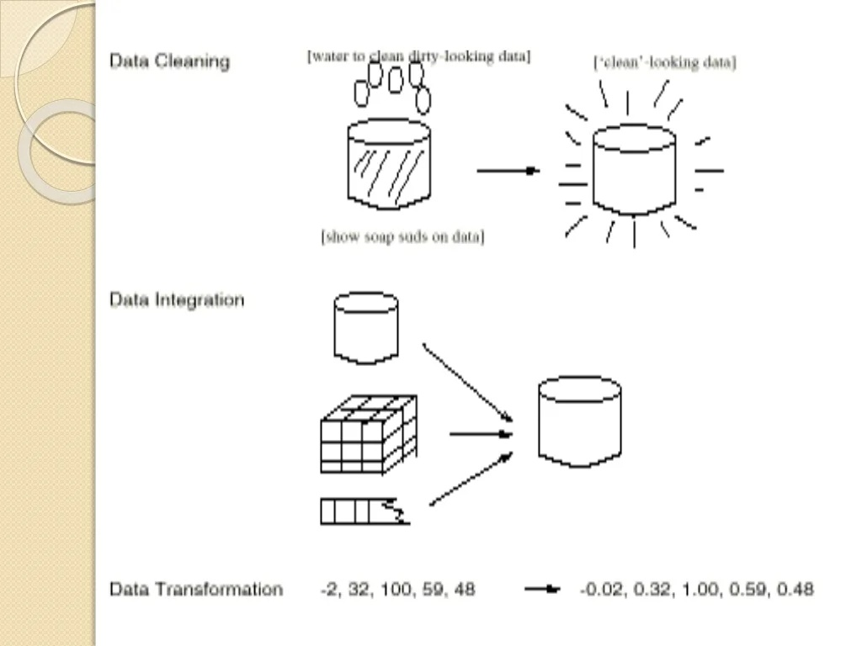

Slide 7
Data cleaning:-Data Cleaning includes filling in missing values, smoothing noisy data, identifying or removing outliers, and resolving inconsistencies.
Data integration:-Data Integration includes integration of multiple databases, data cubes, or files.
Data transformation:-Convert data from legacy or host format to warehouse format.

Slide 8
History Leading to Data Warehousing
Improvement in database technologies, especially relational DBMSs
Advances in computer hardware, including mass storage and parallel architectures
Emergence of end-user computing with powerful interfaces and tools
Advances in middleware, enabling heterogeneous database connectivity
Recognition of difference between operational and informational systems

Slide 9
Need for Data Warehousing
Integrated, company-wide view of high-quality information (from disparate databases).
Separation of operational and informational systems and data (for improved performance).

Slide 10
Facts about data warehousing
• Issues involved in warehousing include techniques for dealing with errors and techniques for efficient storage and indexing of large volumes of data.
• This system is used for reporting and data analysis.
• It usually contains historical data derived from transaction data.
• Data warehousing is not meant for current "live" data.

Slide 11
Components Of Data Warehouse
Sources-Data source interaction
Data Transformation
Data Storage(Data Warehouse)
Data Presentation(Reporting)
Metadata

Slide 12
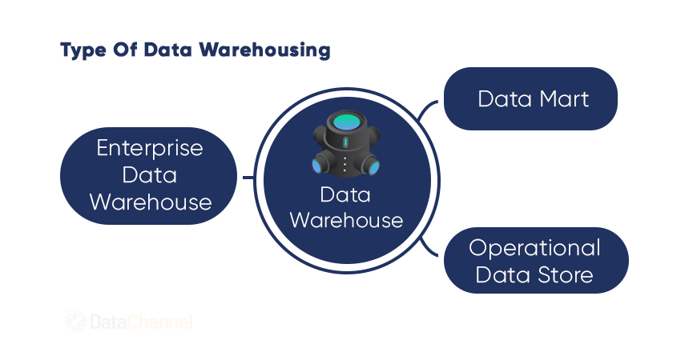

Slide 13
Advantages
Complete control over the four main areas of data management systems:-
Clean data
Query processing : multiple option
Indexes : multiple types
Security : data and access

Slide 14
Disadvantages
Time Consuming Preparation
Difficulty in Compatibility
Maintenance Costs
Limited Use Due to Confidential Information

Slide 15
Data warehouse usage
1.Information Processing:-basic statistical analysis, tables,charts and graphs.
2.Analytical processing:-
Multidimensional analysis of data warehouse data
3.Data Mining:-
Knowledge discovery from hidden patterns

Slide 16
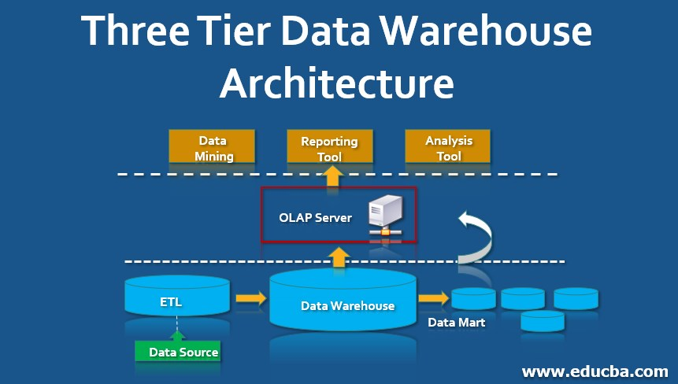
Architecture of data warehouse

Slide 17
Bottom tier:-The bottom tier is a warehoused at a base server that is always a relational database system.
Back-end tools and utilities are used to feed data into the bottom tier from operational databases or other external sources.
. These tools and utilities perform data extraction, cleaning and transformation as well as load and refresh functions to update the data warehouse.
The date extracted using application program interfaces known as gateways.

Slide 18
2)Middle tier:- The middle tier is an OLAPserver that is typically implemented usingeither:
a)
A relational OLAP (ROLAP) model that is, an extended relation DBMS that maps operations. Intermediate server b/w relational back-end server and client frontend tools.
b)
A multidimentional OLAP (MOLAP) model that is, a special purpose server that directly implements multidimentional data and operations. Supports multidimention views.

Slide 19
3.) Top tier:-The top tier is a front -end client layer ,which contains query and reporting tools ,analysis tools, and or data mining tools.
OLAP - Online Analytical Processing :This is the major task of Data Warehousing System.
Useful for complex data analysis and decision making
Market oriented -used by managers, executives and data analyst

Slide 20
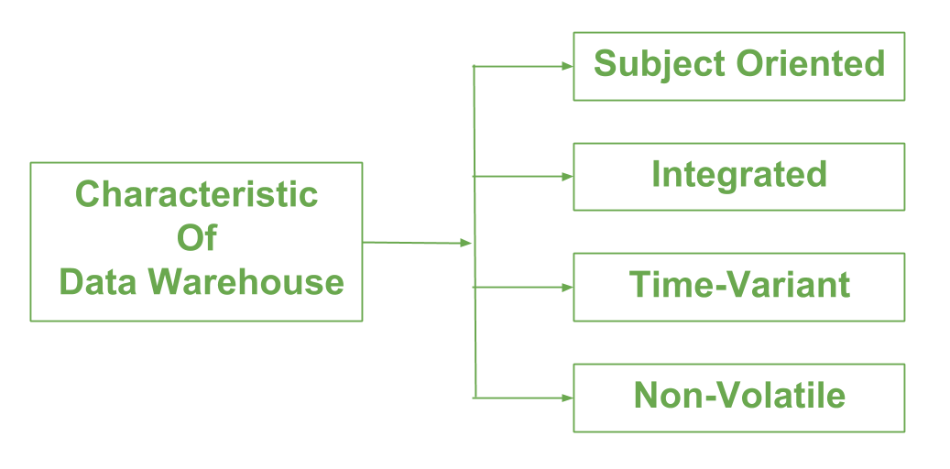

Slide 21
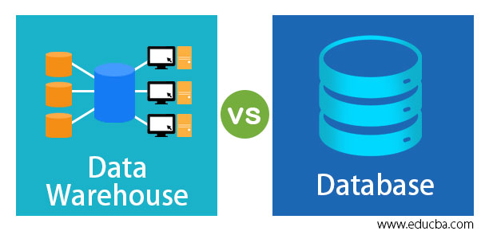

Slide 22
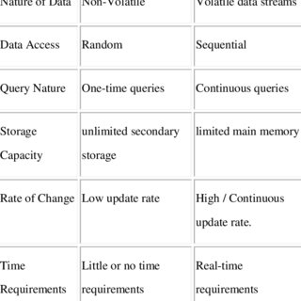
Data warehouse vs DBMS

Slide 23
Organizational Trends Motivating Data Warehouses
No single system of records
Multiple systems not synchronized
Organizational need to analyze activities in a balanced way
Customer relationship management
Supplier relationship management

Slide 24
Conclusion
• Building a corporate-wide data warehouse is a challenging task.
A systematic methodology essential Plan .
the architecture globally but build it incrementally.
Keep user requirements at the core of all development activities.

Slide 25


